Slide 1

Business Analytics
Chapter - 1
Business Analytics
Exploratory Data Analysis & Data Cleaning

Slide 2

Why Clean Data?
Data exploration helps to improve model’s accuracy
Spending significant time on exploration and analyzing data is important.
Garbage in Garbage Out
Major time needs to be spent on data exploration, cleaning and preparation as this would take major part of your project time

Slide 3
Steps For Cleaning
There are 7 steps involved to clean and prepare the data for building predictive model.
Variable Identification
Univariate Analysis
Bi-variate Analysis
Missing values treatment
Outlier treatment
Variable transformation
Variable creation
The above steps could be re-iterated to prepare good data for analysis

Slide 4
Variable Identification
Understand the variables and the type of data for each variable
Identify Predictor(Input) and Target(output)

Slide 5



Business Analytics
Business Analytics
Univariate Analysis

Slide 6
Univariate Analysis(1/2)
Exploring variables one by one.
Used to highlight missing and outlier values
Method to perform univariate analysis depends on whether the variable type is categorical or continuous
Continuous Variables
– The measures help in determining the central value and also the dispersion of the data.
Measures | Visualization Method
Mean | Histogram
Median | Box Plot
Mode
Min
Max
Range
Quartile
IQR
Variance
Standard deviation

Slide 7
Univariate Analysis(2/2)
Categorical Variables
frequency table is used to understand the distribution of each category
Bar plots could be used to visualize the counts
Measured in two metrics, Count and Count% against each category

Slide 8
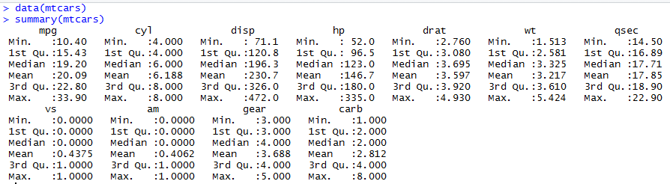
Univariate Analysis in R
data("mtcars")
summary(mtcars)
names(mtcars)
hist(mtcars$mpg)
boxplot(mtcars$mpg,col = "red")

Slide 9
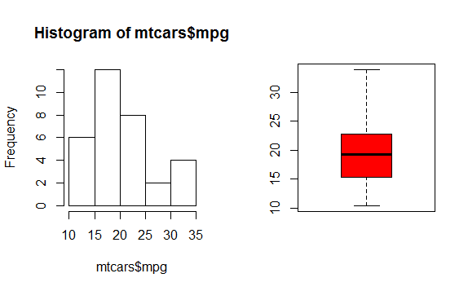
Univariate Analysis in R

Slide 10
Business Analytics
Business Analytics
Bivariate Analysis

Slide 11
Bivariate Analysis
Finds out the relationship between two variables
Can be performed for any combination of categorical and continuous variables.
Different methods are used to tackle different combinations during analysis process.
Possible Combinations:-
Continuous & Continuous
Continuous & Categorical
Categorical & Categorical

Slide 12
Bivariate Analysis - Continuous & Continuous(1/2)
Scatter plot
find out the relationship between two variables
The pattern of scatter plot indicates the relationship between variables
The relationship can be linear or non-linear
Scatter plot shows the relationship between two variable but does not indicates the strength of relationship amongst them
To find the strength of the relationship, we use Correlation(-1 negative linear correlation to +1 positive linear correlation and 0 is no correlation)
Correlation formula: Correlation = Covariance(X,Y) / SQRT(
Var(X)* Var(Y))

Slide 13
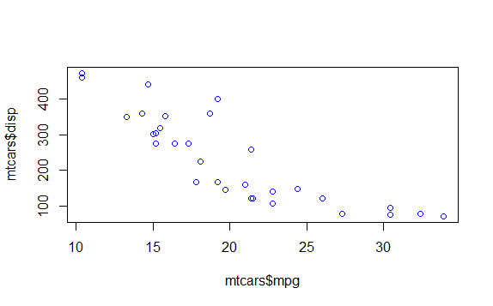
Bivariate Analysis - Continuous & Continuous(2/2)
plot(mtcars$mpg,mtcars$disp,col = "blue")

Slide 14
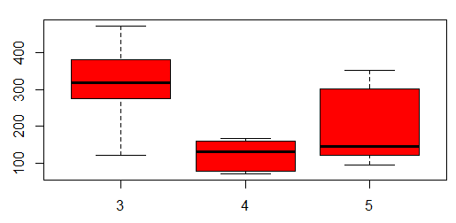
Bivariate Analysis - Continuous & Categorical
Boxplot
– Plot the categorical variable on the x axis and the continuous variable on the y axis
boxplot(mtcars$disp~mtcars$gear, col = "red") # col = blue

Slide 15
Bivariate Analysis - Categorical & Categorical(1/3)
Methods to identify the relationship between two categorical variables.
Two-way table: In this method by creating a two-way table of count and count%. Both row and column represents category of their respected variable.
Stacked Column Chart: This method is one of the most visual form of Two-way table.
Chi-Square Test: It derives the statistical significance of relationship between the variables for a larger population as well. The difference between the expected and observed frequencies in one or more categories in the two-way table.

Slide 16

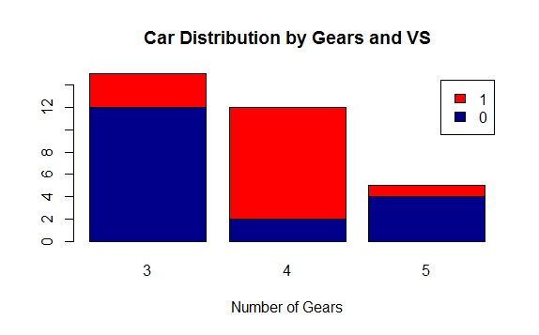
Bivariate Analysis - Categorical & Categorical(2/3)
counts= table (mtcars$vs,mtcars$gear)
counts
barplot(counts, main="Distribution",
xlab = "no of g", col=c("darkblue","red"),
legend = rownames(counts))

Slide 17

Bivariate Analysis - Categorical & Categorical(3/3)
Chi square test
O = observed frequency E = expected frequency
chi-square test is found by
If p<0.05 then it indicates that the relationship between the
variables is significant at 95% confidence

Slide 18
Bivariate Analysis - Categorical & Categorical(3/3)
Chi square test
Presume you observe 100 people to see who deposit garbage in the can and who litters. You want to see if there is a difference based on gender
A person can fall in one of the four categories.
Male, deposit garbage
Male, litters
Female , deposit garbage
Female, litters
 | Deposit | Litter | Total
Female | 18 | 7 | 25
Males | 42 | 33 | 75
Total | 60 | 40 | 100
Given this data, is there a significant difference in littering behavior between men and Women

Slide 19
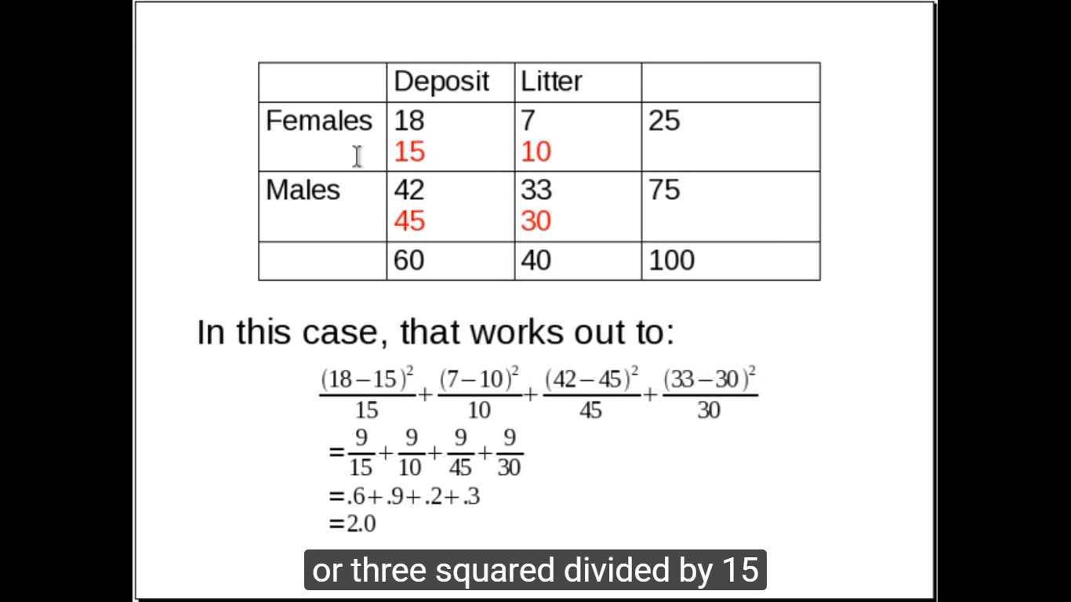
Bivariate Analysis - Categorical & Categorical(3/3)
Chi square test
40*25% = 10
60*75% = 45
40*75% = 30
 | Deposit | Litter | Total
Female | 18 15 | 7 10 | 25
Males | 42 45 | 33 30 | 75
Total | 60 | 40 | 100
Since 60 people deposits their garbage, and 25% of them were female, we would expect 25% of 60 (15) to be the upper cell if there is an equal distribution ( no effect of gender.
O = observed frequency , E = expected frequency

Slide 20
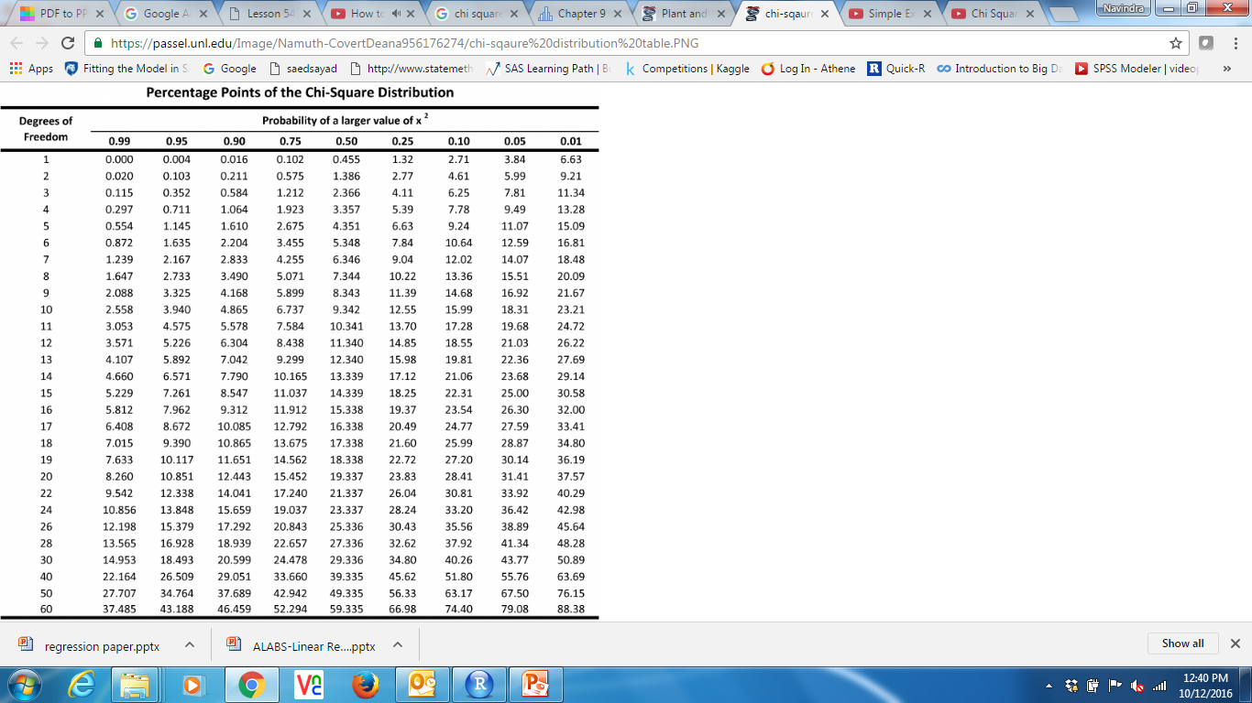
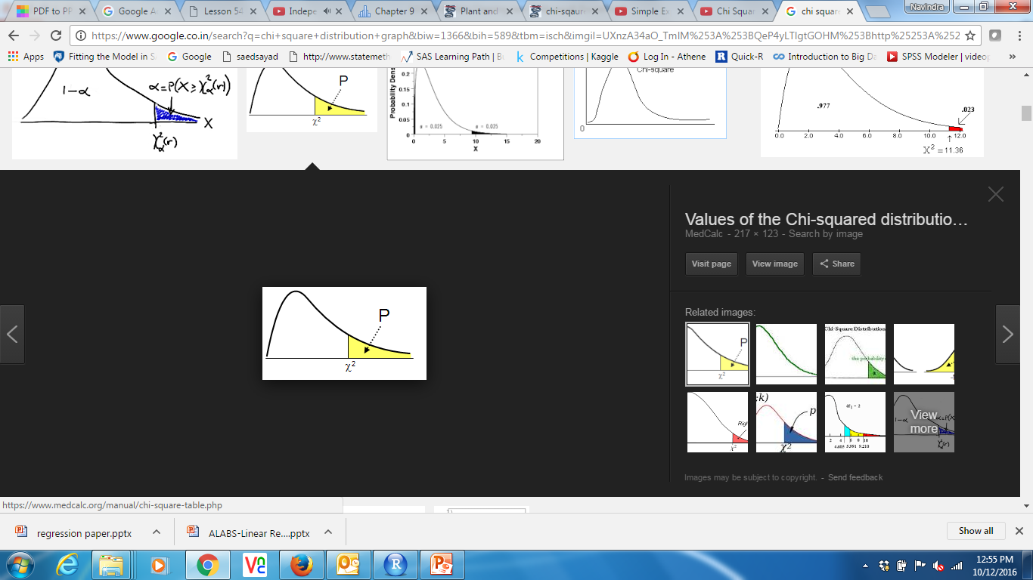
Bivariate Analysis - Categorical & Categorical(3/3)
Chi square test
Looking up the value 2.0 in the chi square table for one degree of freedom ( row-1 * Column-1), we find the probability of this result is 0.16, so you retain the null hypothesis (Ho) :- there is no significant difference based on gender.

Slide 21
Business Analytics
Business Analytics
Missing Values

Slide 22
Missing Value Treatment
There may be situations where there could be missing values in your data.
Handling such values is very important as this could lead to wrong
results.
Missing values could occur due to several reasons like,
During data extraction i.e. while fetching the data required for the analysis
During data collection itself there could be some fields for which the values may not have been collected.
But there are ways to handle these problems

Slide 23
Treating Missing Values
If the dataset has lot of records then we could have the freedom of deleting the entire record where missing values are there
If the variable is continuous then replace the missing values with either mean, median or mode
If the variable is categorical then we could replace the missing values with the most frequent occurring value in that variable

Slide 24
Business Analytics
Business Analytics
Outliers

Slide 25
Outliers (1/2)
What is an Outlier?
Outlier is an observation that appears far away and diverges
from an overall pattern in a sample.
Causes of outliers
Data Entry Errors
Human errors such as errors caused during data collection, recording, or entry can cause outliers in data.
Measurement Error
when the measurement instrument used turns out to be faulty.

Slide 26
Outliers (2/2)
– Intentional Error
This is commonly found in self-reported measures that involves sensitive data.
– Data Processing Error
When data is collected from different sources
– Sampling Error
Data considered which is not part of the sample
– Natural Outlier
When an outlier is not artificial (due to error), it is a natural outlier.

Slide 27
Outliers Impact
It increases the error variance and reduces the power of statistical tests.
If the outliers are non-randomly distributed, they can decrease normality.
They can bias or influence estimates that may be of substantive interest.
They can also impact the basic assumption of Regression, ANOVA
and other statistical model assumptions.

Slide 28
Outlier Impact Example
 | Without Outlier | WithOutlier
 | 1 | 100
 | 2 | 2
 | 3 | 3
 | 4 | 4
 | 5 | 5
Mean | 3.00 | 22.80
Median | 3 | 4
Std. Dev. | 1.58 | 43.17

Slide 29
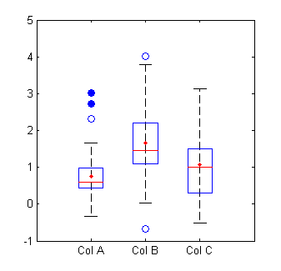
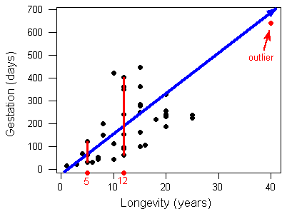
Outlier Detection - Viz
Outliers can be detected using boxplots and scatter plots
EX: 1.The average monthly income of customers is Rs.30,000. But there are also people with monthly income of Rs.5000 and Rs.5L which will be outliers.

Slide 30
Outlier Detection – Thumb Rules
Other than the plots, Outliers can also be detected by using certain thumb rules,
Any value, which is beyond the range of -1.5 x IQR to 1.5 x IQR where IQR = Q3-Q1
Any value which out of range of 5th and 95th percentile can be considered as outlier
Data points, three or more standard deviation away from mean are considered outlier.

Slide 31
Handle Outliers
We could remove the outliers from the data if they are due to data entry or data processing errors
Based on business understanding you could also replace the outliers with mean or median
If there is a pattern of interest in the outliers then they could be handled separately. For example if the outliers are like in groups then treat both groups as two different groups and build individual model for both groups and then combine the output.

Slide 32
Business Analytics
Business Analytics
Feature Engineering

Slide 33
Feature Engineering
Feature engineering is the science (and art) of extracting more information from existing data.
Example
Several variables could be generated from a date variable i.e. Day, month, year, day of the week etc. This information helps a lot in getting idea about different characteristics of the data under study
It can be divided into two steps,
Variable Transformation
Variable Creation

Slide 34
Feature Engineering – Variable Transformation
In data modelling, transformation refers to the replacement of a variable by a function. For instance, replacing a variable x by the square / cube root or logarithm x is a transformation.
When do we transform?
When we want to change the scale of a variable or standardize the values of a variable for better understanding. While this transformation is a must if you have data in different scales
This transformation does not change the shape of the variable distribution
Existence of a linear relationship between variables is easier to
comprehend compared to a non-linear or curved relation.
Variables can be transformed by applying functions like log, square, cube etc. These transformations help in reducing skewness. For right skewed distribution, we take square / cube root or logarithm of variable and for left skewed, we take square

Slide 35
Feature Engineering – Variable Creation
Variable creation is a process to generate a new variables / features based on existing variable(s)
Below is an example of variable creations (Yellow columns are original variables and the columns in blue are variables created from them)
ID | Gender | Date | Day | Month | Year | Dummy_Male | Dummy_Female
1 | Male | 10 May 2016 | 10 | 5 | 2016 | 1 | 0
2 | Female | 15 July 2016 | 15 | 7 | 2016 | 0 | 1
3 | Male | 01 June 2016 | 1 | 6 | 2016 | 1 | 0
4 | Male | 04 January 2016 | 4 | 1 | 2016 | 1 | 0
5 | Female | 27 March 2016 | 27 | 3 | 2016 | 0 | 1

Slide 36
Thank You

